Slide 1


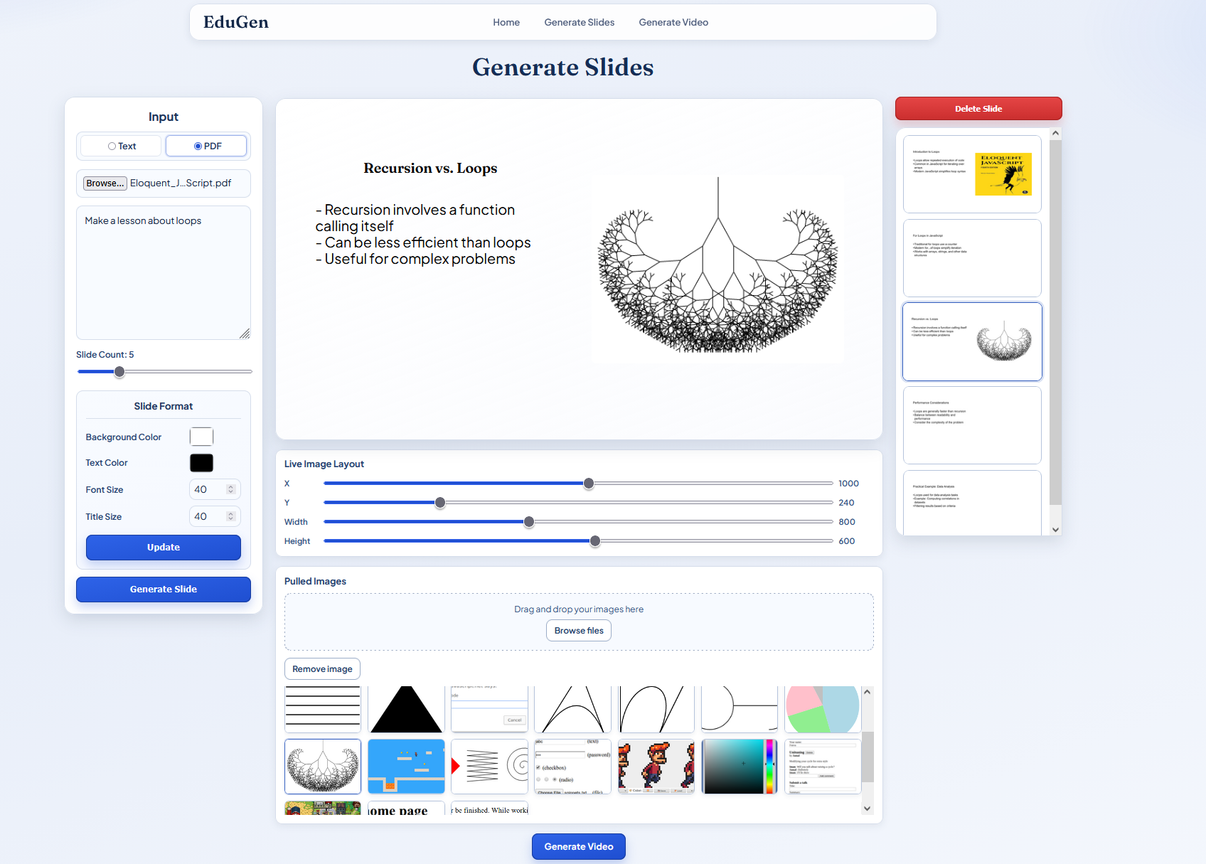
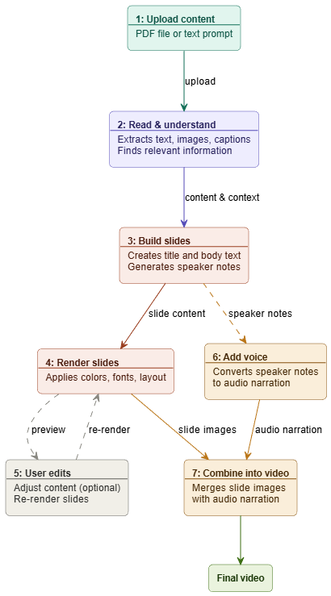
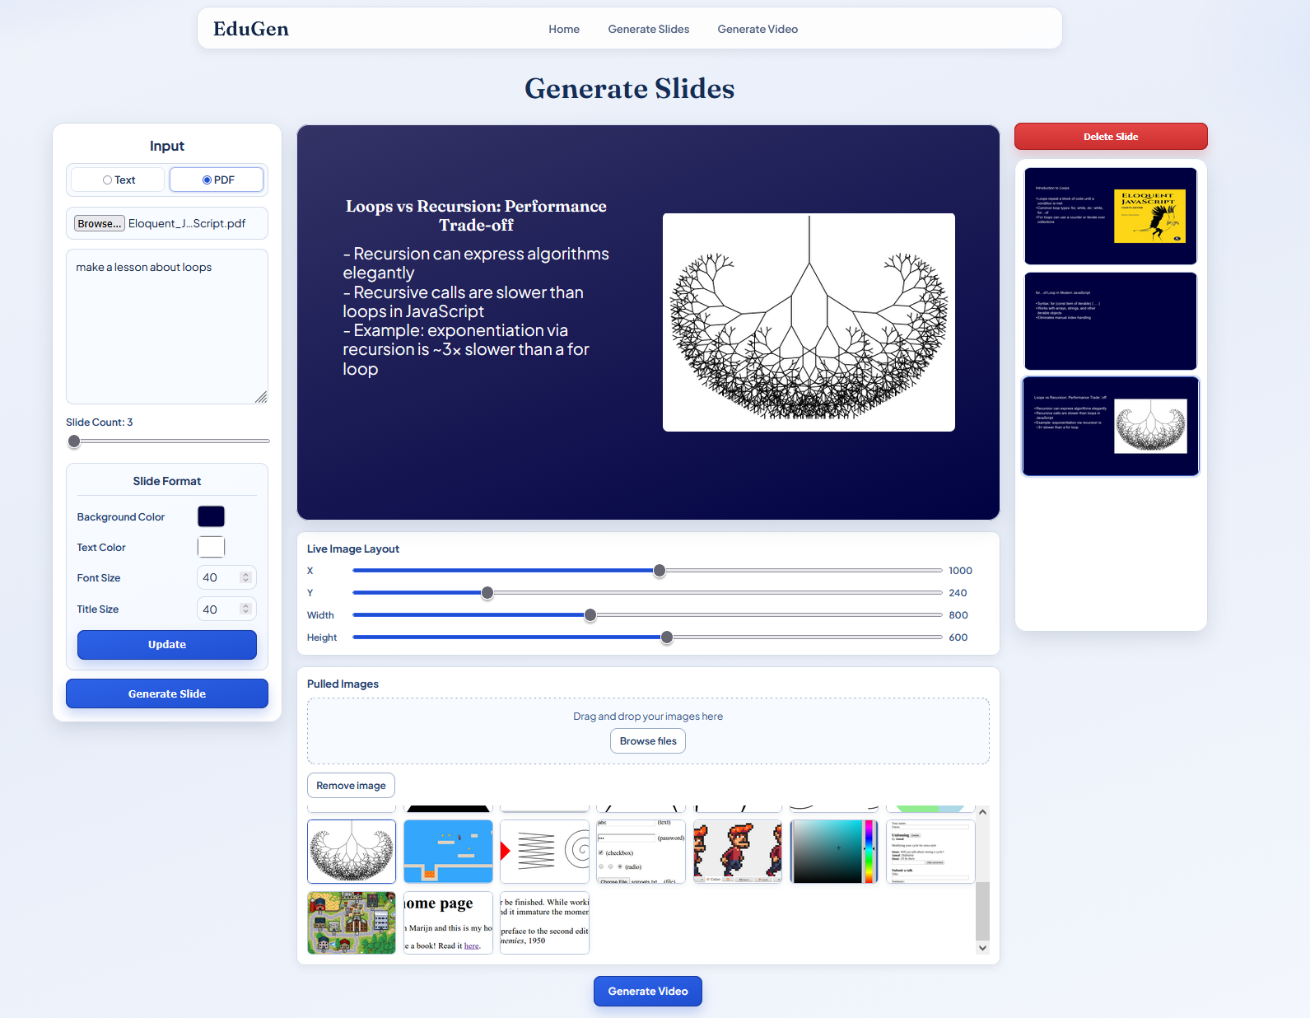
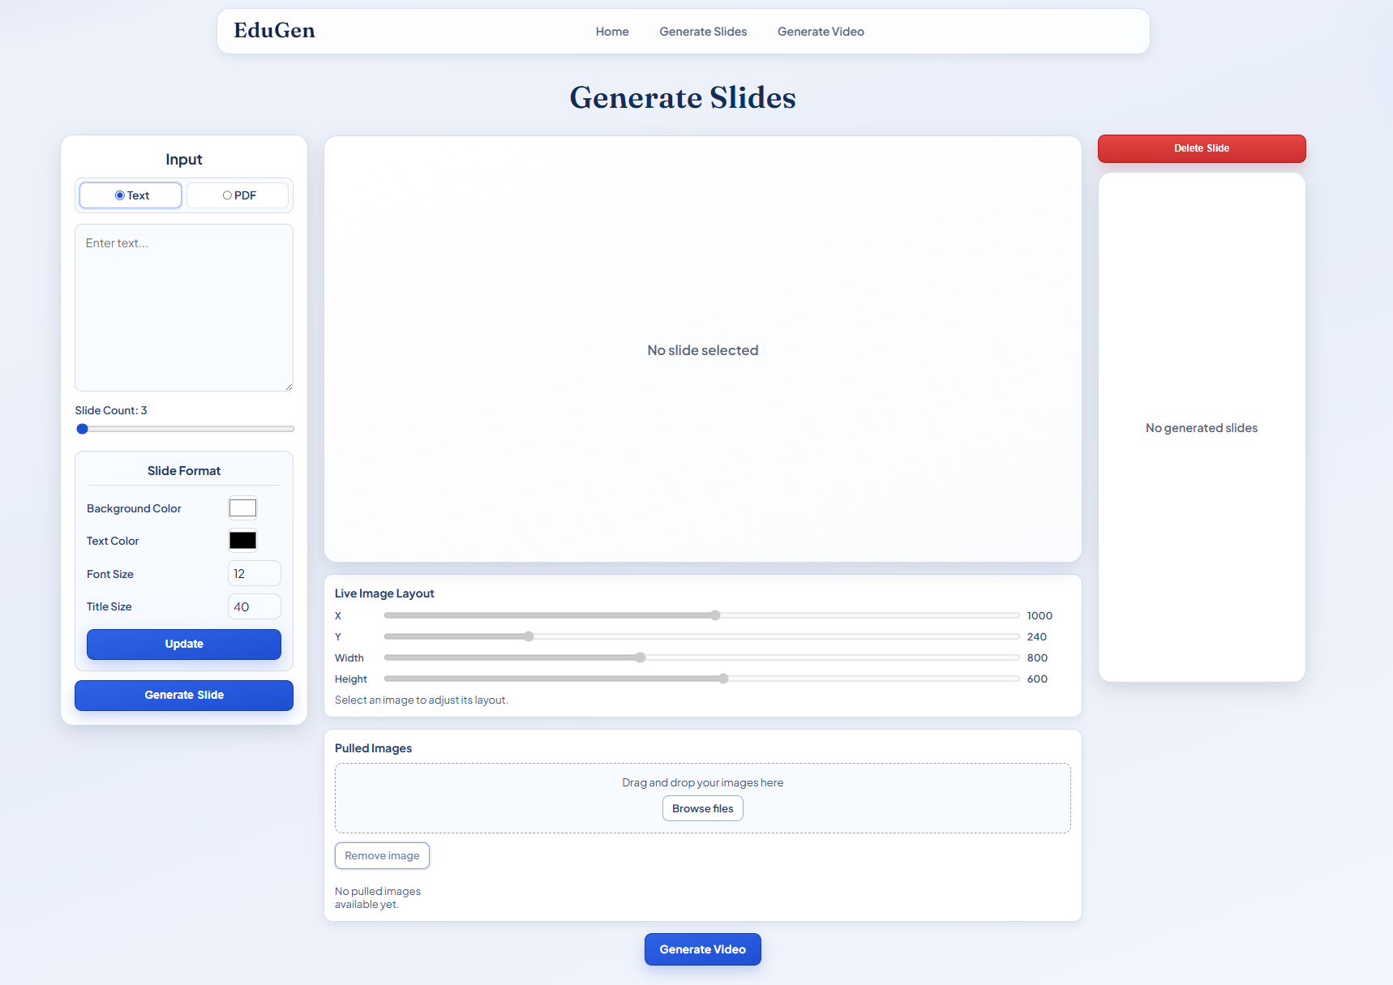
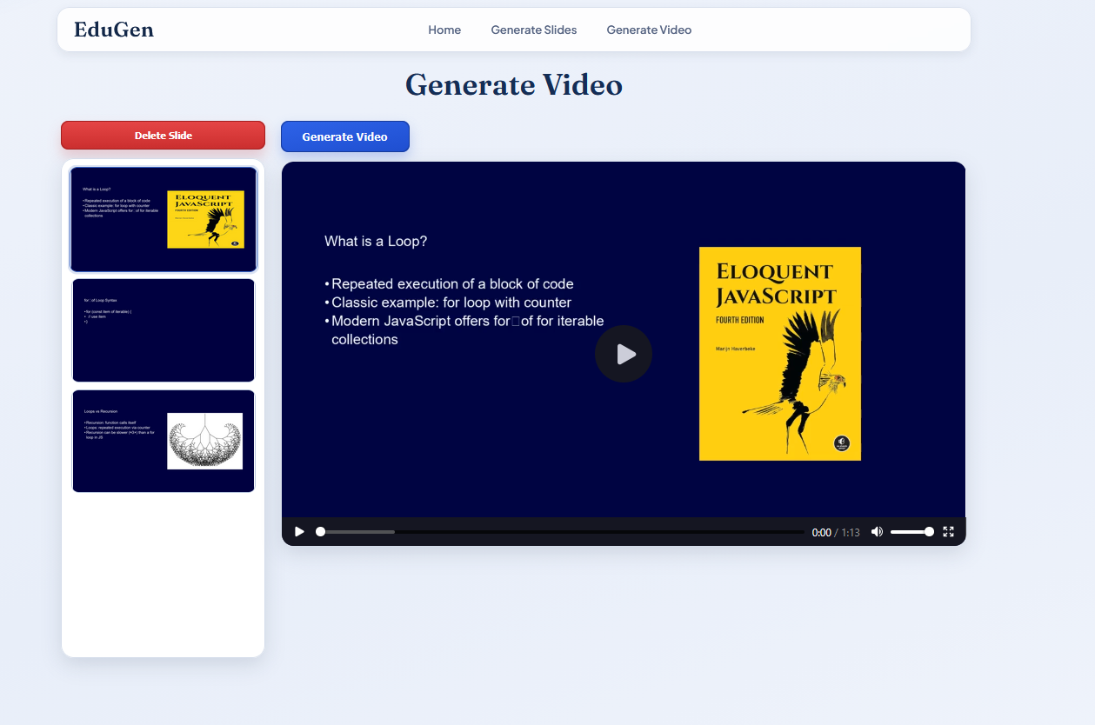
EduGen:
An AI-Powered Pipeline for Automated Educational Slideshow and Video Generation with RAG-Enhanced Accuracy
Group Members: Kyle Arquilla, Nathanael Craver, Richard Joyner
Research Advisor: Deepshikha Bhati
Abstract
EduGen is an AI tool that helps educators quickly create slideshow presentations and narrated educational videos from their course materials. It can take PDFs, extract the important text and images, and use that information to generate grounded slide content with fewer made-up details.
Teachers can either build presentations from their own materials or generate slides from a topic prompt. The system automatically handles tasks like choosing content, formatting slides, selecting images, adding narration, generating captions, and creating transitions. It also includes an editor so educators can manually adjust slides or request changes in plain language before producing the final video.
In short, EduGen is designed to save educators time by automating the video lesson creation process while still giving them control over the final content.
Applications
For Educators:
Generate lecture slides from course PDFs or textbooks
Create narrated video lessons with no other tools
Easily update and reformat slide when course material changes
For Students:
Create review slides from readings or notes
Generate video summaries of course slides
Convert dense readings into clear, structured visual explanations
Features
Upload PDFs or paste text to automatically generate slides
Customize slide themes, colors, and text sized before and after generation
Edit, add, or remove content
Reposition images, choose from an image gallery, or upload your own images for full control over layout
QR Codes

